Slide 1

BUDGET DRAFT
Superintendent Recommended Budget
2020 – 2021 school year
Mark Villanti, Ed.D.
March 31, 2020

Slide 2

Agenda for Budget Adoption
Introduction:
Impact of COVID - 19
Are taxpayers getting a return on their investment?
Responsible decision-making.
Implementing the strategic plan to promote academic excellence.
Reviewing budget highlights.
Assessing fiscal fitness.
3 part budget.
Providing voter information.
Line by line budget.

Slide 3
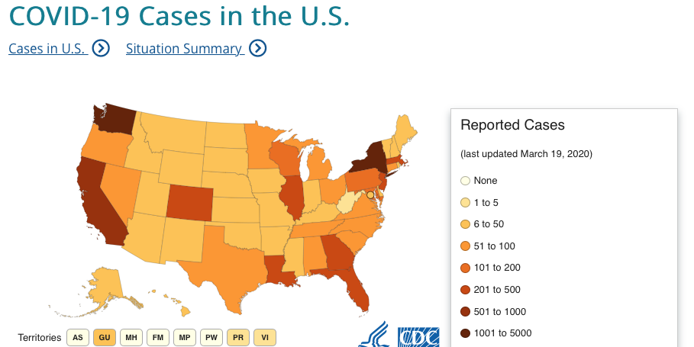
What will be the fiscal impact of COVID – 19?

Slide 4
State Budget /Economy
We have reduced our state revenue forecasts in this budget.
What is the impact of the economic down-turn on this budget?
Our reserves are healthy and that is a plus.
Impact is less on this budget and more on 2021 – 2022.
We are in the throes of the crisis. We do not fully understand the end game, good and bad.

Slide 5
Evidence of moderating
growth & cost controls
Five year histories of …
Tax levy increases.
History of district valuation.
Fiscal solvency.
Budget to budget comparisons.

Slide 6
What are
the responsible decisions?
Presenting a budget that is under the tax cap.
Maintaining a smaller, student centered learning environment.
Communicating the academic successes of the district and promoting the economic vitality of the Spackenkill Union Free School District.
Seeking additional revenues through out-of-district tuition program.
This proposed budget is well under the TAX CAP.

Slide 7
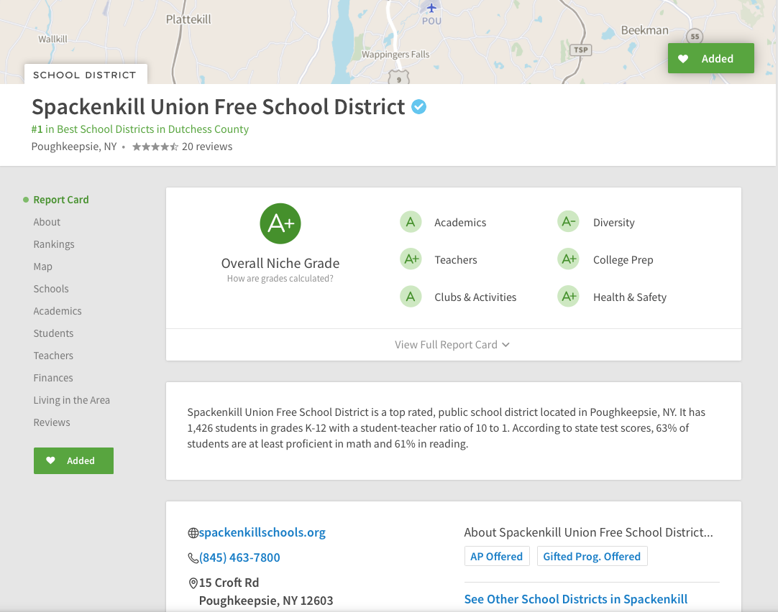

Slide 8
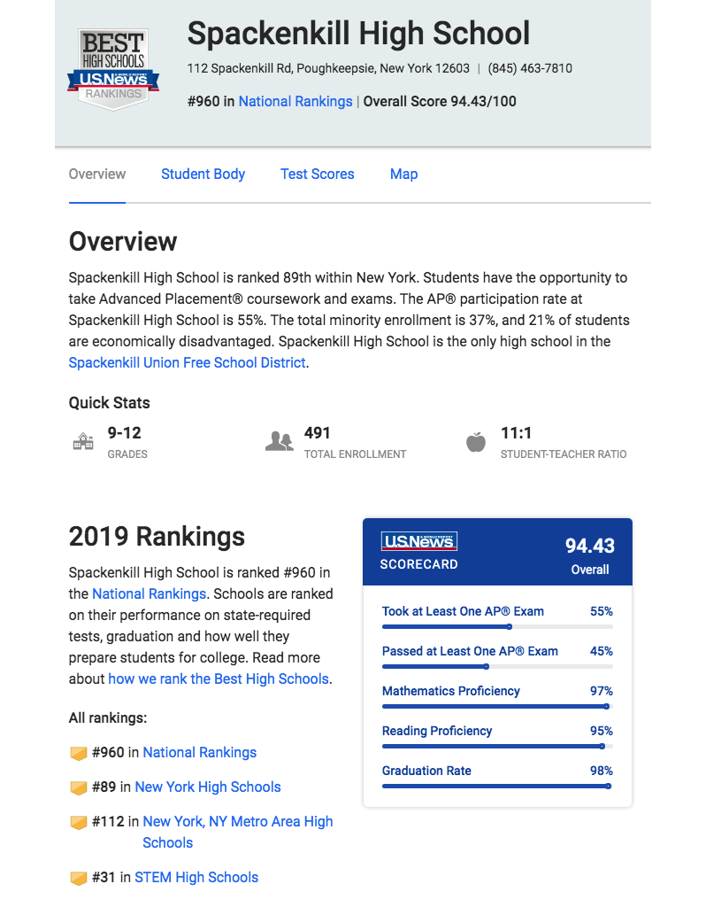
Communicating District Success
Spackenkill HS is ranked in top 6% of ranked schools nationally and 7% of ranked schools in New York State.
The STEM program was selected 31st out 1,000 schools nationally.

Slide 9
Spackenkill Schools continue to be as desirable as ever. Renters are buying; those who have small homes are selling and buying bigger ones. A lot of buyers and not enough homes to go around.
…Local Realtor, 2020
The greater the desirability of the school district, both taxpayers and families win. Property values increase creating home equity for residents and a stronger tax base for the school district.
Board of Education approved strategic plan…

Slide 10
Change, continuous improvement
Who Moved My Cheese, Dr. Spencer Johnson, 1999.
He knew he had learned something useful about moving on from his mice friends, Sniff and Scurry. They kept life simple. They didn’t overanalyze or overcomplicate things. When the situation changed and the cheese had been moved, they changed and moved with the cheese. He would remember that.
The very core message of the book is this: things constantly change so we must adapt. The quicker we adapt a change the more satisfied we will be and organizations that don’t change with changing circumstances will become extinct or less effective.

Slide 11
Professional Development
Sharpening the saw (Collins, Good to Great)
Balanced literacy. K – 6 initiative with Mike Clarke, 4th year of a 5-year initiative. See video and transcript for a sense of Mike Clarke’s work with grade 6 teachers.
Middle School math alignment to Next Generation Standards with Dr. Sobrin and MS math teachers. 2nd year of a two-year plan.
Improving classroom management strategies with Dr. Donna Riter. 2nd year of a multi-year plan.

Slide 12

Literacy PD: M. Clarke
https://drive.google.com/file/d/1NQibTx_I6YtvfKsCBZkGuEgArymynx5Q/view?usp=sharing

Slide 13
Professional Development
AVID (Advancement via individual determination) at Todd MS. This model targets students that are low income, parents have not graduated from college, and performing below potential). It’s intended to close the achievement gap. Dan Doherty will present at March BOE.
MS / HS science alignment. Liz Mirra consultant. Align curriculum with the NYS Next Generation Standards.

Slide 14
IT Department
The recommendations of an IT Audit indicate that we are understaffed requiring one more position to comply with the new education law 2D.
Our day-to-day operations are functioning satisfactorily although we need to add some protocols, policies and procedures. We will unpack the full audit with the BOE once it is received in writing.
We need a Help Desk position. This position will assist the Director of IT to remain focused on the “big picture” especially system vulnerabilities and new Part 2 D Privacy Law compliance.

Slide 15
Staffing and C & I
Create the position of an Assistant Superintendent for K – 6 Instruction / Elementary Principal (given the economic climate we are not adding a position but revising a position).
Review job description (this will be revised subject to board discussion).
Review and discuss revised Organizational Chart.
Given the economic uncertainty as a result of the pandemic crisis, it is recommended that a principal take on this added role with a stipend, just as was done when Dr. Mulford accepted additional work responsibilities.

Slide 16
Budgetary Implications
Professional Development
Literacy initiative
Classroom strategies
Math initiative
AVID
Help Desk position
Assistant Superintendent
Grants
Title II grant
Title IV grant
Title II grant
Title IV For PD & FTEs within Todd MS
Operating Budget – PT to FT TBD, $30 to $40 K
Salary stipend.

Slide 17
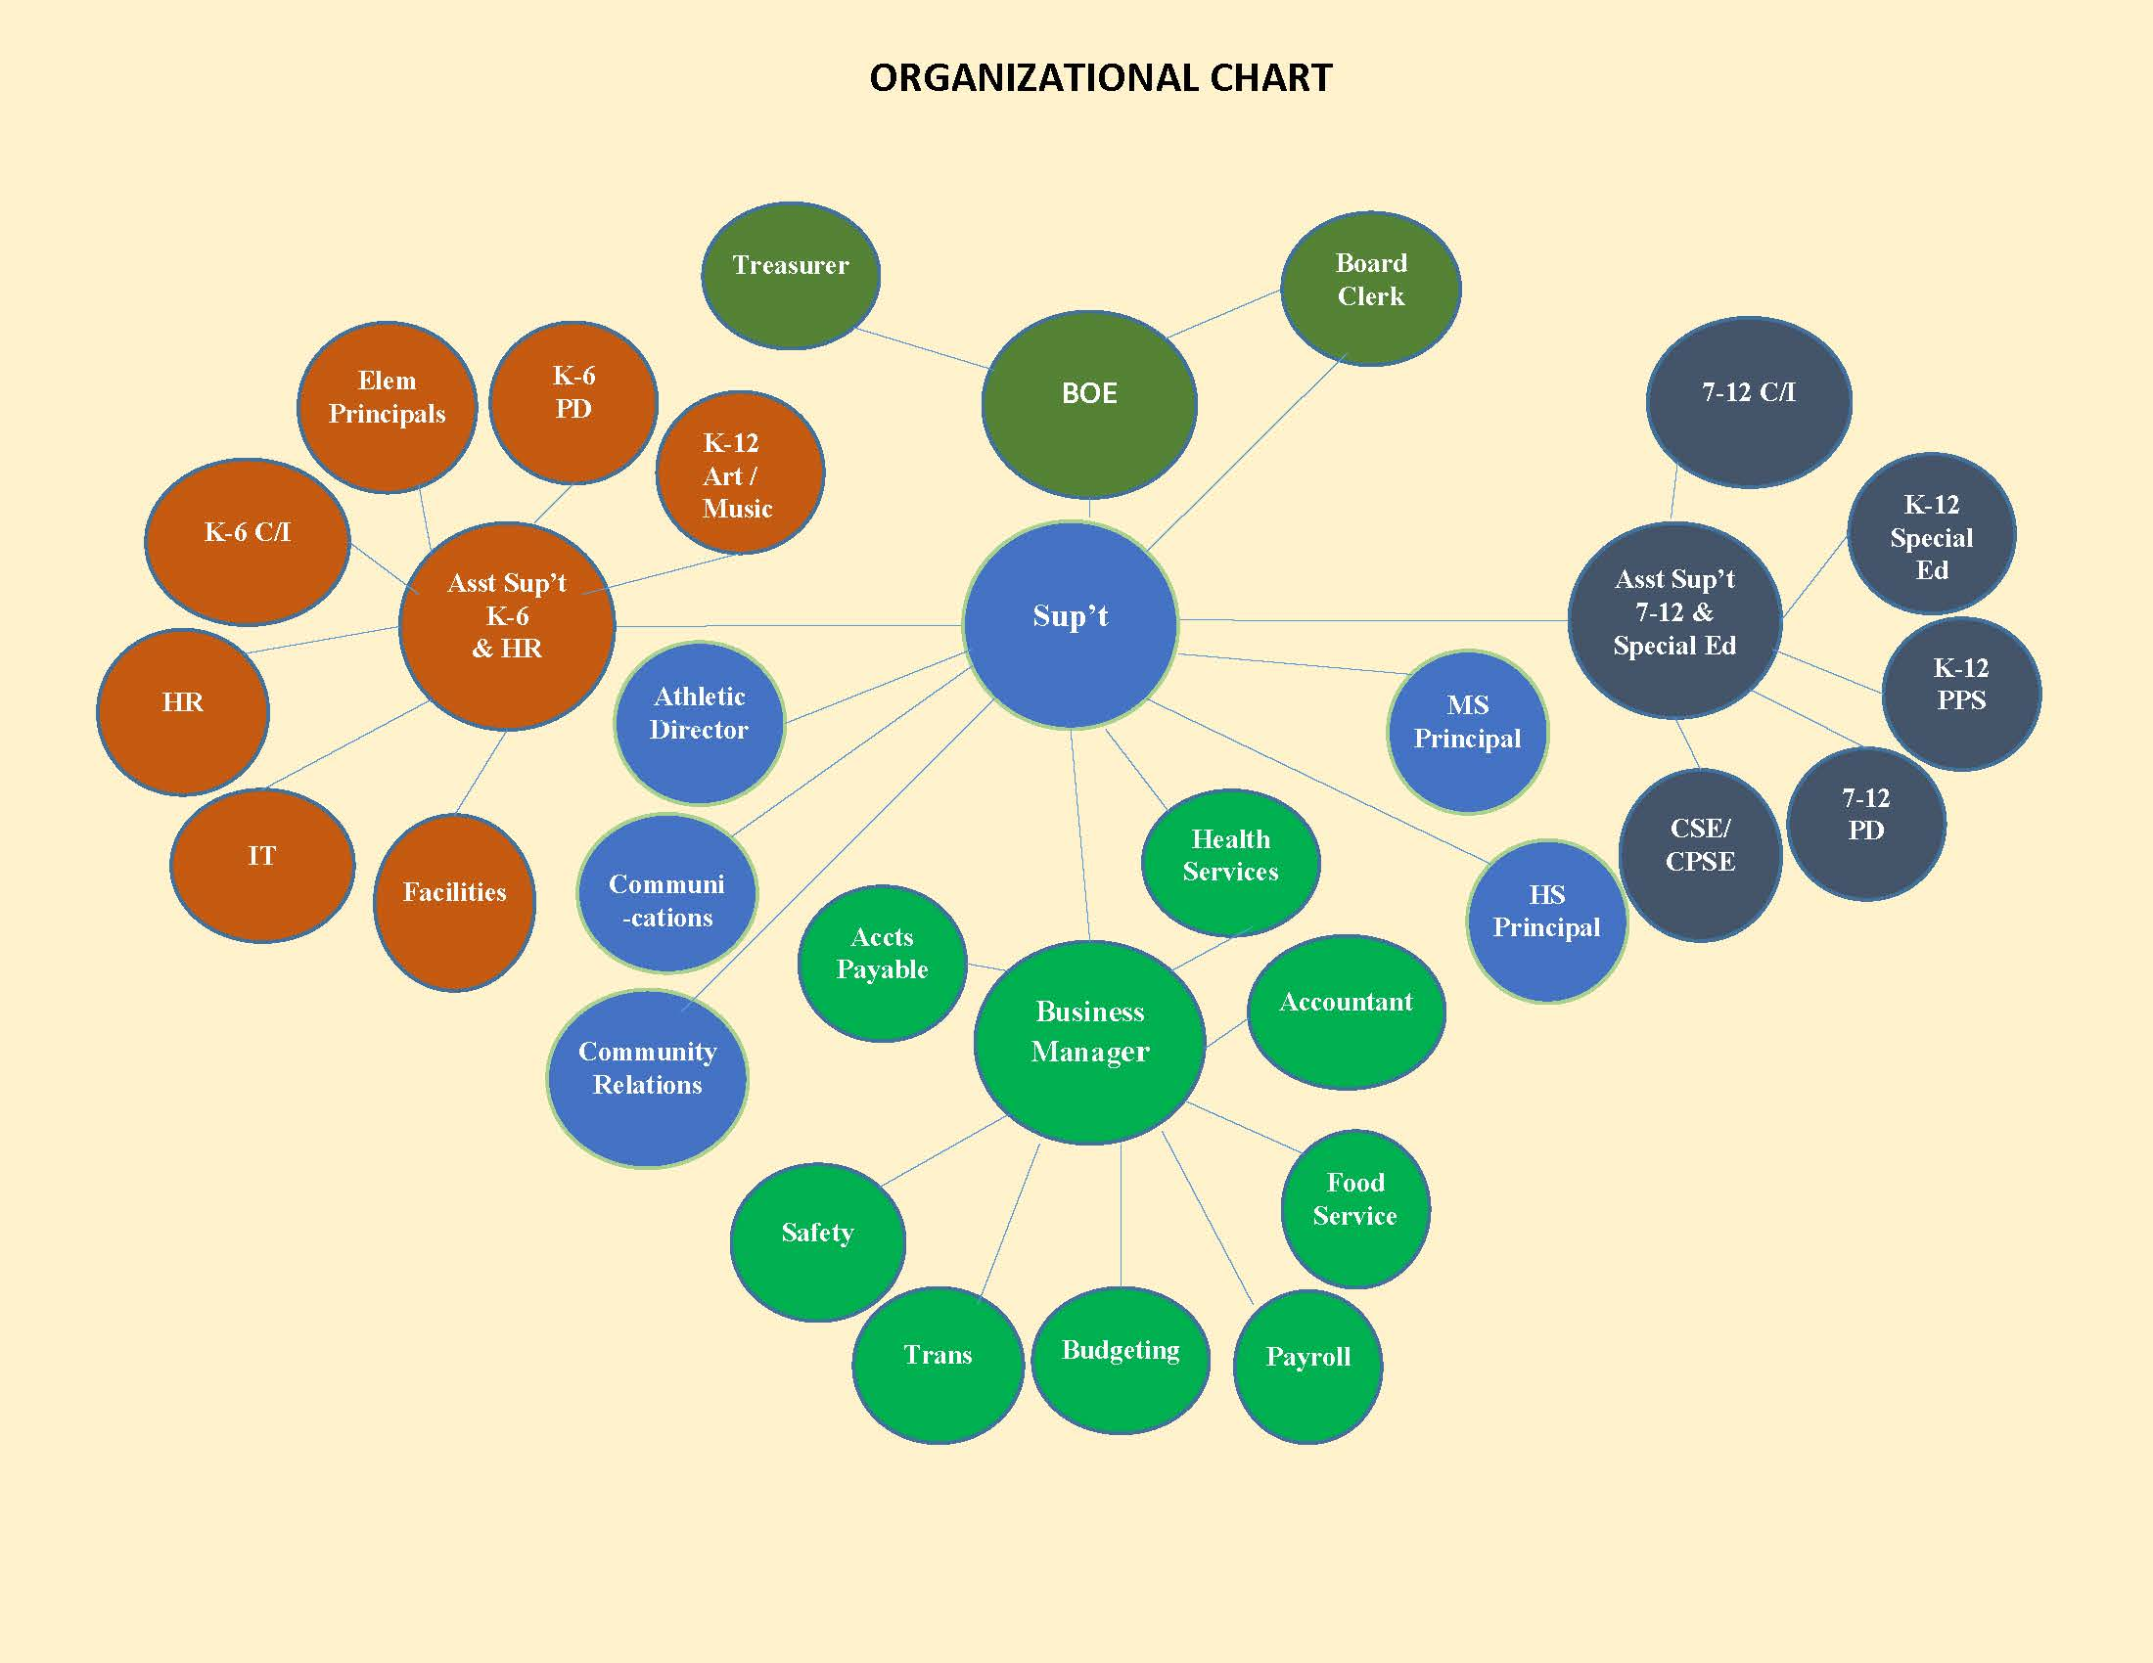
Notes:
Organizational chart from Mary F.

Slide 18
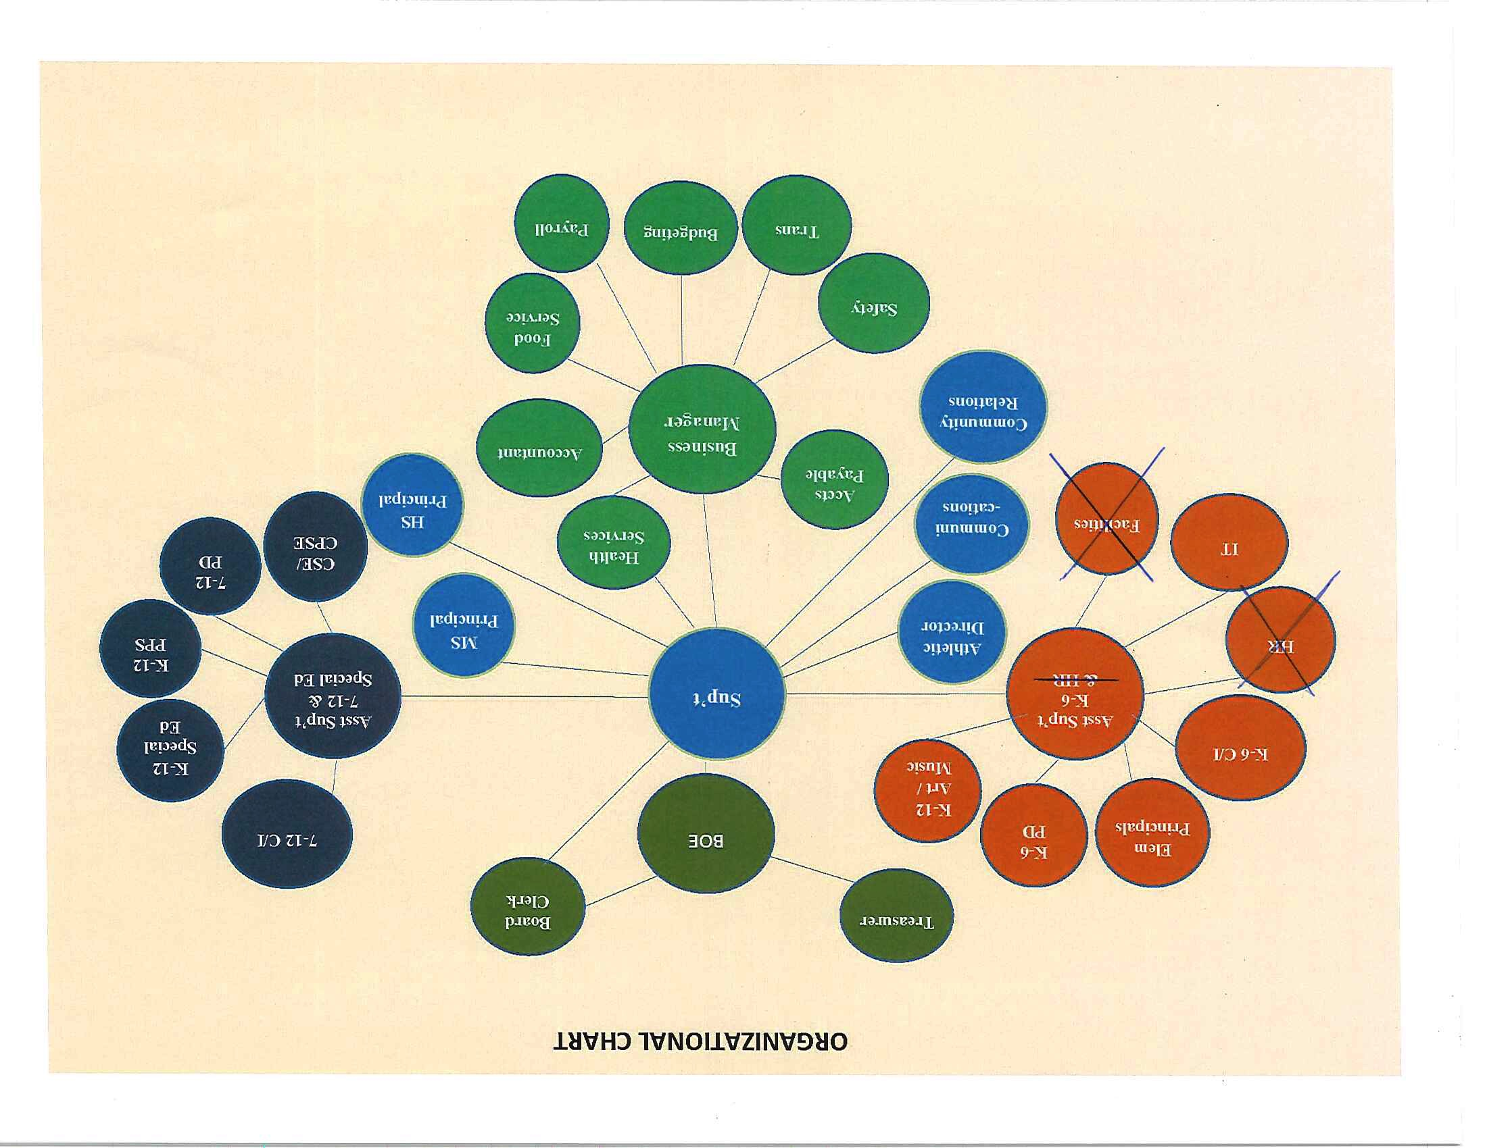

Slide 19
State Aid Revenues
School Aid 2019 - 20
School Aid 2020 - 21
Category | Amount
Foundation aid | $5,354,574
BOCES | $1,372,655
High Tax Aid Hardware & Tech | $ 341,381 $28,581
Software, Library, Text Book | $128,133
High cost excess cost | $106,947
Private excess cost | $189,261
Transportation | $1,143,715
Building Aid | $1,366,966
Total | $10,031,966
Category | Amount
Foundation aid | $7,583,565
BOCES
Hardware & Tech
Software, Library, Textbook
High cost excess cost | $123,186
Private excess cost | $230,745
Transportation | $1,252,921
Building Aid | $1,504,012
Total | $10,694,429

Slide 20
Revenues: Revised
Governor’s Budget
$10,694,429
Our Revised Budget
$10,614,429

Slide 21
2019 Spackenkill School District
Tax Warrant and Tax Rates
2019 Tax Warrant was $30,299,099 as estimated at Budget Adoption
2019 Tax Warrant increase was 2.51%
Homestead Non-Homestead
Assessments 7.41% 2.63%
Rate Increase -4.51% -.17%
Rate per thousand $22.25 $58.00
Based on a house assessed a $200,000 , a tax decrease of approximately $212 in 2019

Slide 28
Key Cost Budget Drivers
2020-2021 Budget
Salaries $23,891,736 49%
Health Insurance $ 7,949,899 17%
BOCES $ 3,853,169 8%
Employees' Retirement $ 614,000
Teachers' Retirement $ 2,076,075 6%
Debt Service $ 2,555,888 5%
Total of key drivers $40,940,767 85%
Total Budget $48,068,456

Slide 29
Projected Budget Increases: 2020-21
Salaries $23,891,736 .5%
Health Insurance $ 7,949,899 1.5%
BOCES $ 3,853,169 3.5%
Employees' Retirement $ 614,000 (10%)
Teachers' Retirement $ 2,076,075 3.8%
Debt Service $ 2,555,888 26%
Total of key drivers $40,940,767
Total Budget $48,068,456

Slide 30
2020 – 2021 Budget Overview
2020 - 2021 Superintendent’s Budget $48,068,456
2019 - 2020 Budget $47,162,497
Increase Amount $ 905,959
Percent Increase 1.92%
Tax Levy Increase 1.89%

Slide 31
2020– 2021 Tax Cap Calculation
Key Factors
The Average Annual Change in the CPI for 2019 was less than 2% making the Allowable Levy Growth Factor for the 2020-2021 Tax Levy Limit 1.81%
No exclusions for TRS or ERS
Tax levy increase cannot exceed 3.7% (rounding) based on exclusions for district capital expenses and growth factor
Tax levy proposed will not exceed 2.99%

Slide 32
Superintendent’s Recommended
2020-21 Budget
Superintendent’s Budget $48,068,456
Maximum Tax Levy $31,444,286
March, 2020 Estimated Tax Levy $30,871,945
Amount Under Tax Cap $ 572,341

Slide 33
OVERALL BUDGET PROPOSAL
THREE PART BUDGET
Administrative- Salaries & benefits of administrators, admin clerical staff, school board costs, tax collection, legal & auditing costs, BOCES admin costs and central data processing. $ 4,401,071
Program – Salaries & benefits of all teachers and support staff; textbooks, instructional materials, equipment, athletics, BOCES programs, special ed. services and transportation. $ 36,743,917
Capital – Salaries & benefits of custodial and maintenance staff, debt service, bus purchases, utilities and insurance. $ 6,923,468

Slide 34
Remove from Service
Bus # 41 – 2006 22 passenger bus 111,733 miles
  Due to age of vehicle and high miles it would
  be cost prohibitive to expend funds to pass
  DOT inspection
Bus # 43 – 2009 28 passenger bus 74,779 miles
  Due to age of vehicle and rust issues within the body of the bus, underneath the bus it would be cost prohibitive to expend funds to pass DOT inspection

Slide 35
Cost Analysis
Replace bus 41 with one 24-passenger bus
  Cost not to exceed $56,638
Replace bus 43 with a 30-passenger bus
  Cost not to exceed $55,628
Purchase vehicles NYS Contract
Quotes are from state contract

Slide 36
Est. Cost Analysis
Approximate Gross Cost $112,266
Estimated State Aid $ 64,174
paid over a 5-year period
Net Cost $ 48,092
* Aid based on 2019-20 Governor’s proposal

Slide 37
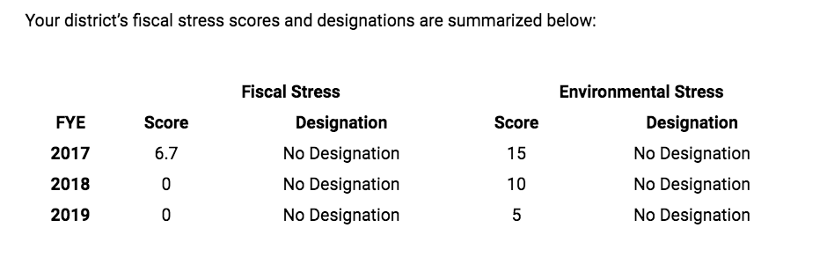

Slide 38
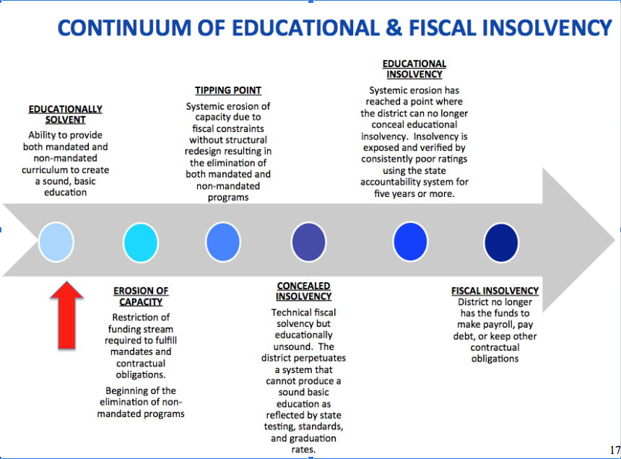

Slide 39
CONTINGENCY BUDGET
The contingency budget requires the levy to remain the same as 2019-2020.
In real dollars this means a cut of
$ 195,068 from our budget.

Slide 40
BUDGET VOTE
When? Some time after June 1
Where? We do not know if this will be an in-person or remote voting via ballots.
Note. We are planning for paper ballots. Absentee ballots can be requested by email by writing to sandra.barbieri@sufsdny.org and mailed in.
What? Spending plan - $ 48,068,456
One Board of Education Trustee
Bus purchase proposition

Slide 41
Budget Link
The complete listing of budget documents are available on line at the following link:
www.spackenkillschools.org/departments/business office/budget_information

